Slide 1


Mohamed Mostafa Ramadan Mohamed
May 30, 2022

Slide 2

Outline
Executive Summary
Introduction
Methodology
Results
Conclusion
Appendix

Slide 3
Executive Summary
Summary of methodologies
Data collection
Data wrangling
EDA with data visualization
EDA with SQL
Building an interactive map with Folium
Building a Dashboard with Plotly Dash
Predictive analysis (Classification)
Summary of all results
Exploratory data analysis results
Interactive analytics demo in screennshots
Predictive analysis results

Slide 4
Introduction
Project background and context
The The era of commercial space has arrived, and there are several companies that are making
space travel affordable for everyone. Perhaps the most successful of them is SpaceX, and on of
the reasons is that their rocket launch is relatively inexpensive.
SpaceX advertises Falcon 9 rocket launches on its website, with a cost of 62 million dollars;
other providers cost upward of 165 million dollars each, much of the savings is because SpaceX
can reuse the first stage.
Therefore, we will predict if the Falcon 9 first stage will land successfully. If we can determine
if the first stage will land, we can determine the cost of a launch. This information can be used if
an alternate company wants to bid against SpaceX for a rocket launch.
Problems you want to find answers
- Correlations between each rocket variables and successful landing rate
- Conditions to get the best results and ensure the best successful landing rate

Slide 5

Section 1

Slide 6
Methodology
Executive Summary
Data collection methodology:
SpaceX API & Web Scraping List of Falcon 9 and Falcon Heavy launches - Wikipedia
Perform data wrangling
Convert outcomes into Training Labels with the booster successfully/unsuccessful landed
Perform exploratory data analysis (EDA) using visualization and SQL
Perform interactive visual analytics using Folium and Plotly Dash
Perform predictive analysis using classification models
Find best Hyperparameter for SVM, Classification Trees and Logistic Regression

Slide 7
Data Collection
The data collection process includes a combination of API requests from the SpaceX API and web scraping data from a table in the Wikipedia page of SpaceX, Falcon 9 and Falcon Heavy Launches Records.
○ SpaceX API Data Columns: FlightNumber, Date, BoosterVersion, PayloadMass, Orbit,
LaunchSite, Outcome, Flights, GridFins, Reused, Legs, LandingPad, Block,
ReusedCount, Serial, Longitude, Latitude
○ Wikipedia Web Scrape Data Columns: Flight No., Launch site, Payload, PayloadMass,
Orbit, Customer, Launch outcome, Version Booster, Booster landing, Date, Time.
SpaceX API Web Scraping
Request data from Space API
API returns Space data in JSON file
Normalize data into CSV file
Get HTML Response from Wikipedia page
Extract data using beautiful soup
Normalize data into CSV file

Slide 8
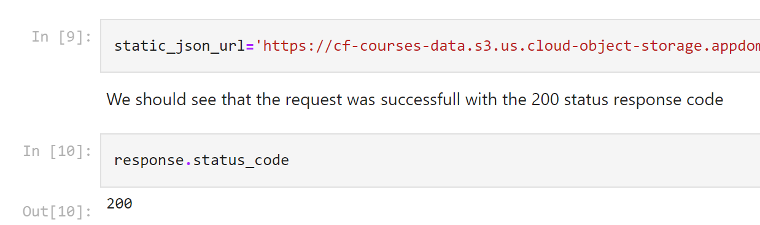
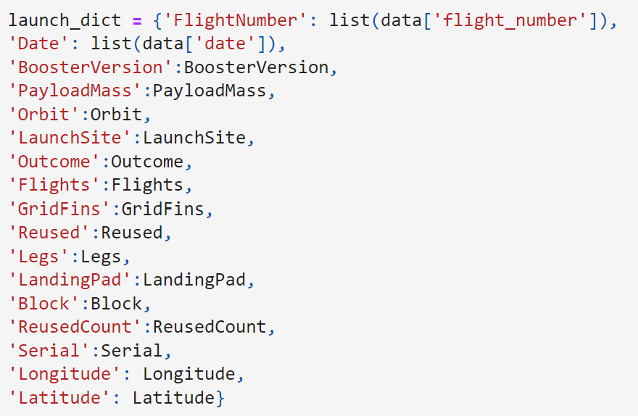
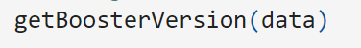
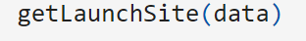


Data Collection – SpaceX API
1. Requesting rockts launch data from spaceX API
2. Converting Response to a josn file
3. Using customer functions to clean data
Applied_Data_Science_Capstone_SPACE_X/Data_Collection_SpaceX_API.ipynb at master · mohkipic/Applied_Data_Science_Capstone_SPACE_X (github.com)
4. Combining the columns into a dictionary to create data frame
5. Filtering dataframe and exporting to a csv

Slide 9
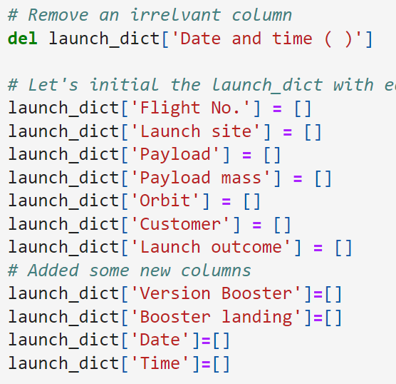
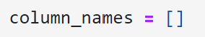
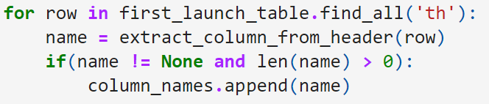
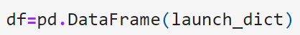
Data Collection - Scraping
1. Getting response from HTML
2. Creating a BeautifulSoup object
3. Finding all tables and assigning the result to a list
4. Extracting colum name one by one
Applied_Data_Science_Capstone_SPACE_X/Data_Collection_Scraping.ipynb at master · mohkipic/Applied_Data_Science_Capstone_SPACE_X (github.com)
5. Creating an empty dictionary with keys
6. Filling up the launch_dict with launch records
(Too long to put in here, so please refer to the notebook)
7. Creating a Dataframe and exporting it to a CSV

Slide 10
Data Wrangling
There are several cases in which the booster failed to successfully land on the dataset, and sometimes it attempted to land but failed because of accident.
○ True Ocean: the mission result has successfully landed in a specific area of the ocean
○ False Ocean: the mission result has not successfully landed in a specific area of the ocean
○ True RTLS: the mission result successfully landed on the ground pad
○ False RTLS: the mission result has not successfully landed on the ground pad
○ True ASDS: the mission result has successfully landed on the drone ship
○ False ASDS: the mission result has not landed on the drone ship
• Converting these results into training labels:
○ 1 = successful / 0 = failure
Applied_Data_Science_Capstone_SPACE_X/Data_Wrangling.ipynb at master · mohkipic/Applied_Data_Science_Capstone_SPACE_X (github.com)

Slide 11
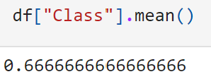
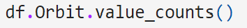
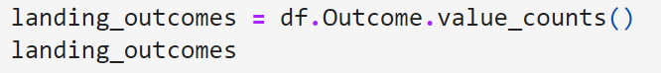
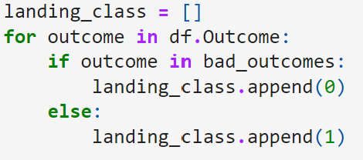
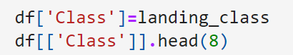
Data Wrangling
1. Calculating the number of launches at each site
2. Calculating the number and occurrence of each orbit
3. Calculating the number and occurrence of mission
outcome per orbit type
4. Creating a landing outcome label from outcome
column
Applied_Data_Science_Capstone_SPACE_X/Data_Collection_SpaceX_API.ipynb at master · mohkipic/Applied_Data_Science_Capstone_SPACE_X (github.com)
5. Combining the columns into a dictionary to create data frame
6. Filtering dataframe and exporting to a csv

Slide 12
EDA with Data Visualization
Scatter chart:
○ Flight Number vs. Launch Site
○ Payload vs. Launch Site
○ Flight Number vs. Orbit Type
○ Payload vs. Orbit Type
○ A scatter plot shows how much one variable is affected by another. The relationship between two variables is called a correlation. This plot is generally composed of large data bodies.
• Bar chart:
○ Orbit Type vs. Success Rate
○ A Bar chart makes it easy to compare datasets between multiple groups at a glance. One axis represents a category and the other axis represents a discrete value. The purpose of this chart is to indicate the relationship between the two axes.
• Line chart:
○ Year vs. Success Rate
○ A Line chart shows data variables and trends very clearly and helps predict the results of data that has not yet been recorded.
Applied_Data_Science_Capstone_SPACE_X/EDA_with_Data_Visualization.ipynb at master · mohkipic/Applied_Data_Science_Capstone_SPACE_X (github.com)

Slide 13
EDA with SQL
Loading the dataset into the corresponding table in a Db2 database, and executing SQL queries to answer following questions:
○ Displaying the names of the unique launch sites in the space mission
○ Displaying 5 records where launch sites begin with the string 'CCA’
○ Displaying the total payload mass carried by boosters launched by NASA (CRS)
○ Displaying average payload mass carried by booster version F9 v1.1
○ Listing the date when the first successful landing outcome in ground pad was achieved
○ Listing the names of the boosters which have success in drone ship and have payload mass greater than 4000 but less than 6000
○ Listing the total number of successful and failure mission outcomes
○ Listing the names of the booster_versions which have carried the maximum payload mass
○ Listing the failed landing_outcomes in drone ship, their booster versions, and launch site names for in year 2015
○ Ranking the count of landing outcomes (such as Failure (drone ship) or Success (ground pad)) between the date 2010-06-04 and 2017-03-20, in descending order
Applied_Data_Science_Capstone_SPACE_X/EDA_with_SQL.ipynb at master · mohkipic/Applied_Data_Science_Capstone_SPACE_X (github.com)

Slide 14
Build an Interactive Map with Folium
Objects created and added to a folium map:
○ Markers that show all launch sites on a map
○ Markers that show the success/failed launches for each site on the map
○ Lines that show the distances between a launch site to its proximities
• By adding these objects, following geographical patterns about launch sites are found:
○ Are launch sites in close proximity to railways? Yes
○ Are launch sites in close proximity to highways? Yes
○ Are launch sites in close proximity to coastline? Yes
○ Do launch sites keep certain distance away from cities? Yes
Applied_Data_Science_Capstone_SPACE_X/Interactive_Map_with_Folium.ipynb at master · mohkipic/Applied_Data_Science_Capstone_SPACE_X (github.com) / Applied_Data_Science_Capstone_SPACE_X/Interactive_Map_with_Folium - PDF.pdf at master · mohkipic/Applied_Data_Science_Capstone_SPACE_X (github.com)

Slide 15
Build a Dashboard with Plotly Dash
The dashboard application contains a pie chart and a scatter point chart.
○ Pie chart
■ For showing total success launches by sites
■ This chart can be selected to indicate a successful landing distribution across all launch sites or to indicate the success rate of individual launch sites.
○ Scatter chart
■ For showing the relationship between Outcomes and Payload mass (Kg) by different boosters
■ Has 2 inputs: All sites/individual site & Payload mass on a slider between 0 and 10000 kg
■ This chart helps determine how success depends on the launch point, payload mass, and booster version categories.
Applied_Data_Science_Capstone_SPACE_X/Dashboard_with_Plotly_Dash.py at master · mohkipic/Applied_Data_Science_Capstone_SPACE_X (github.com) (Code Only)

Slide 16
Predictive Analysis (Classification)
Perform exploratory Data Analysis
and determine Training Labels
○ Create a column for the class
○ Standardize the data
○ Split into training data and test
data
• Find best Hyperparameter for SVM,
Classification Trees and Logistic
Regression
○ Find the method performs best
using test data
Applied_Data_Science_Capstone_SPACE_X/Predictive_Analysis_Classification.ipynb at master · mohkipic/Applied_Data_Science_Capstone_SPACE_X (github.com)
BUILDING MODEL
EVALUATING MODEL
IMPORVING MODEL
FINDING THE BEST PERFORMING CALSSIFICATION MODEL

Slide 17
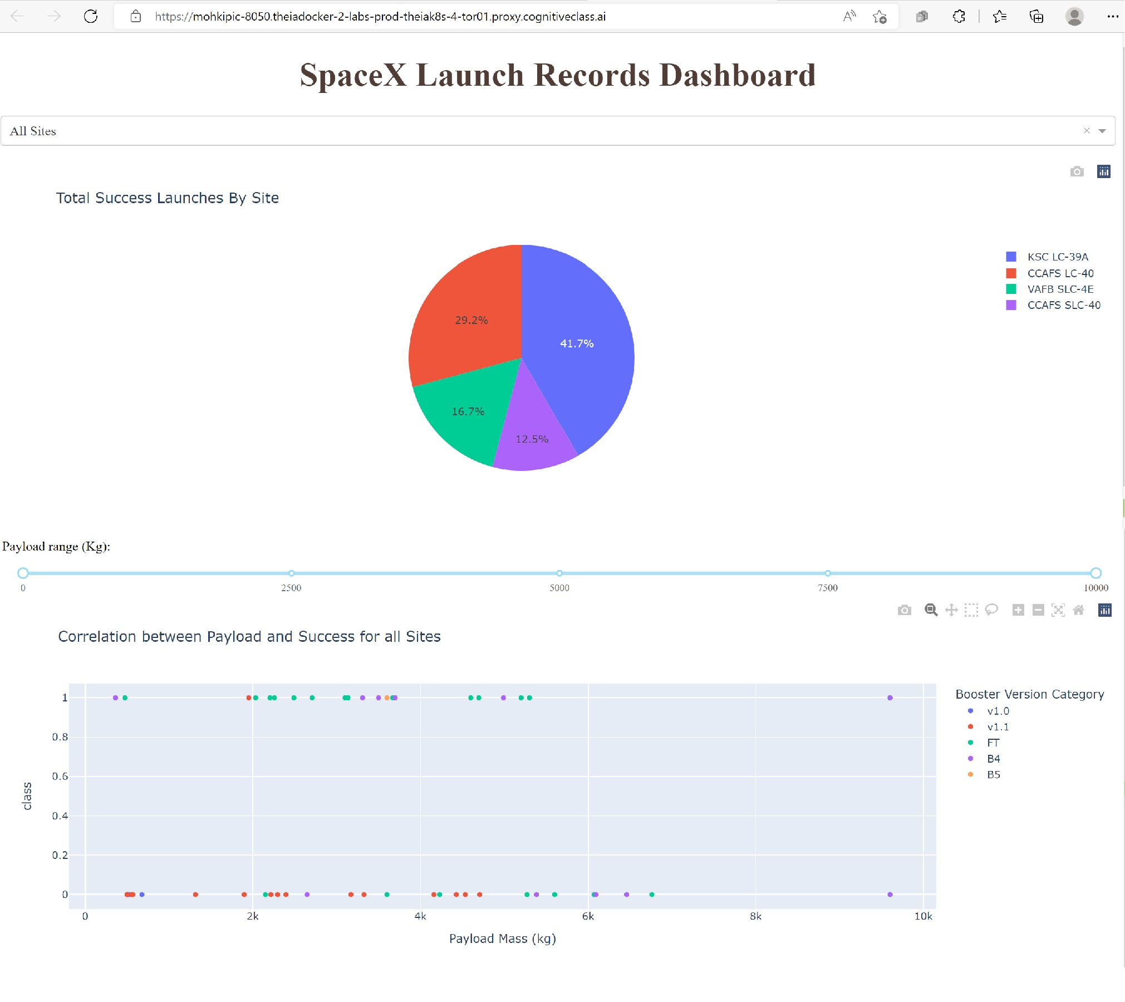
Results
The screenshot is a
preview of the Dashboard
with Plotly Dash.
• The results of EDA with
visualization, EDA with SQL,
Interactive Map with Folium,
and Interactive Dashboard
will be shown in the next
slides.
• Comparing the accuracy of
the three methods, return
the same accuracy of about
83% for test data and one with
77%.

Slide 18

Section 2

Slide 19
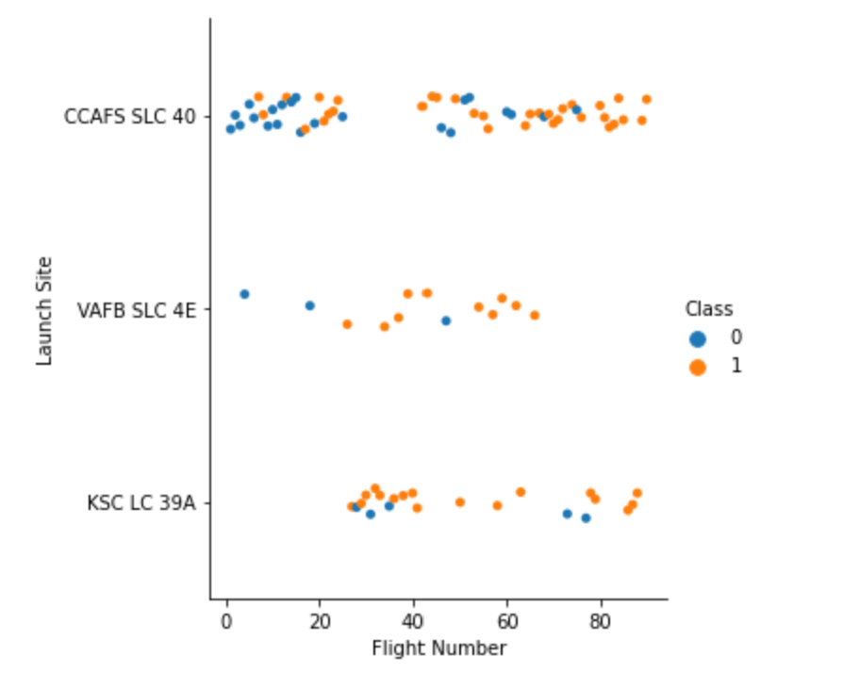
Flight Number vs. Launch Site
Class 0 (blue) represents
unsuccessful launch, and Class 1
(orange) represents successful launch.
• This figure shows that the success
rate increased as the number of
flights increased.
• As the success rate has increased
considerably since the 20th flight,
this point seems to be a big
breakthrough.

Slide 20
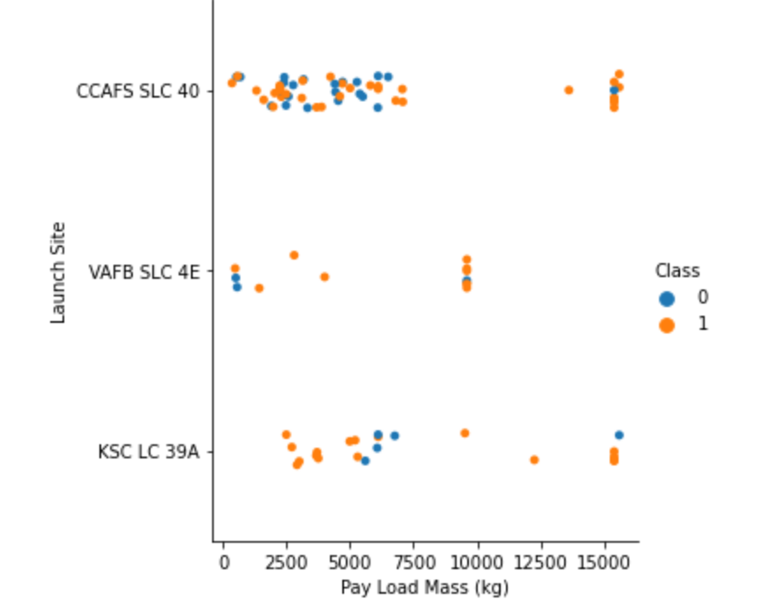
Payload vs. Launch Site
Class 0 (blue) represents
unsuccessful launch, and Class 1
(orange) represents successful launch.
• At first glance, the larger pay load
mass, the higher the rocket’s
success rate, but it seems difficult
to make decisions based on this
figure because no clear pattern
can be found between
successful launch and Pay Load
Mass.Show a scatter plot of Payload vs.

Slide 21
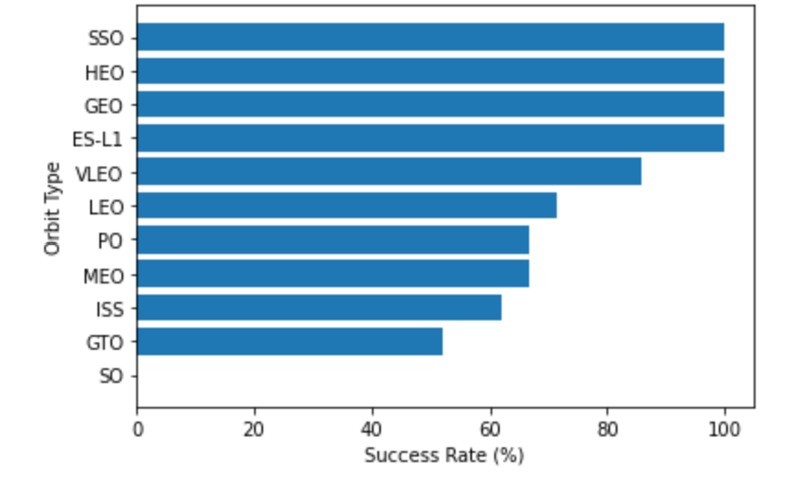
Success Rate vs. Orbit Type
Orbit types SSO, HEO, GEO, and
ES-L1 have the highest success
rates (100%).
• On the other hand, the success rate
of orbit type GTO is only 50%, and
it is the lowest except for type SO,
which recorded failure in a single
attempt.

Slide 22
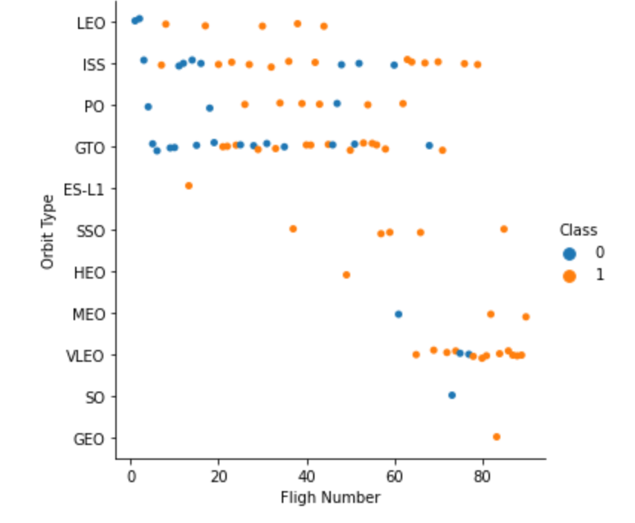
Flight Number vs. Orbit Type
Class 0 (blue) represents
unsuccessful launch, and Class 1
(orange) represents successful launch.
• In most cases, the launch outcome
seems to be correlated with the
flight number.
• On the other hand, in GTO orbit,
there seems to be no relationship
between flight numbers and
success rate.
• SpaceX starts with LEO with a
moderate success rate, and it
seems that VLEO, which has a high
success rate, is used the most in
recent launches.

Slide 23
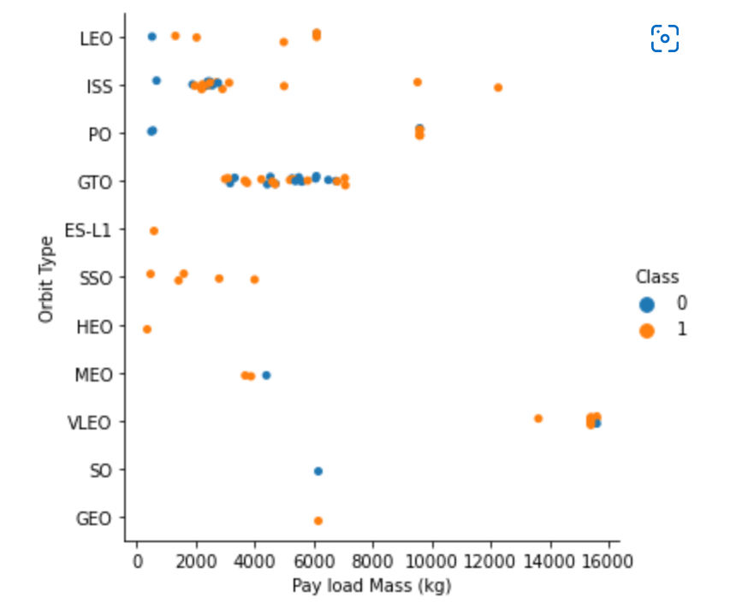
Payload vs. Orbit Type
Class 0 (blue) represents
unsuccessful launch, and Class 1
(orange) represents successful launch.
• With heavy payloads the successful
landing or positive landing rate are
more for LEO and ISS.
• However, in the case of GTO, it is
hard to distinguish between the
positive landing rate and the
negative landing because they are
all gathered together.

Slide 24
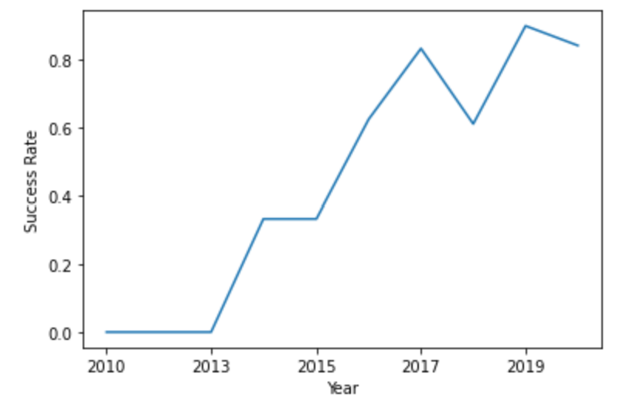
Launch Success Yearly Trend
Since 2013, the success rate has
continued to increase until 2017.
• The rate decreased slightly in 2018.
• Recently, it has shown a success
rate of about 80%.

Slide 25
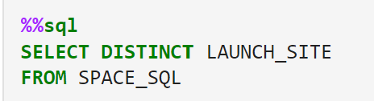
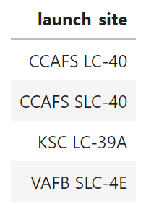
All Launch Site Names
Query
• Result
• When the SQL DISTINCT clause is
used in the query, only unique
values are displayed in the
Launch_Site column from the
SpaceX table.
• There are four unique launch sites:
CCAFS LC-40, CCAFS SLC-40,
KSC LC-39A, VAFB SLC-4E

Slide 26
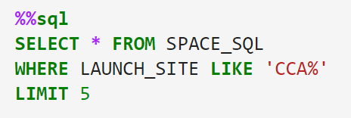
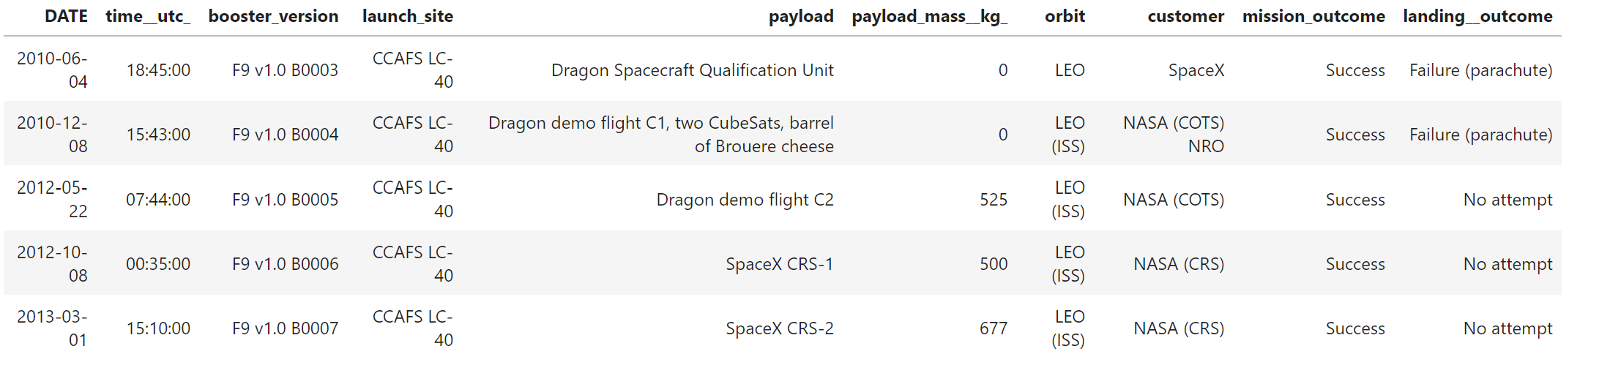
Launch Site Names Begin with 'CCA'
Query
• Result
• Only five records of the SpaceX
table were displayed using LIMIT 5
clause in the query.
• Using the LIKE operator and the
percent sign (%) together, the
Launch_Site name starting with
CAA could be called.

Slide 27
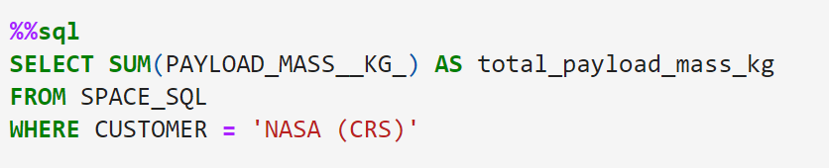
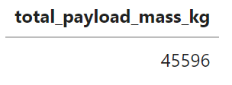
Total Payload Mass
Query
• Result
• Using the SUM() function to
calculate the sum of column
PAYLOAD_MASS__KG_.
• In the WHERE clause, filter the
dataset to perform calculations only
if Customer is NASA (CRS).

Slide 28
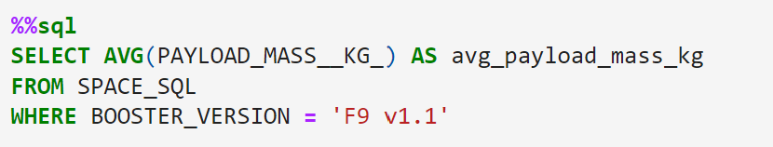
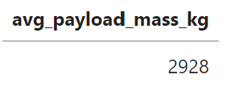
Average Payload Mass by F9 v1.1
Query
• Result
• Using the AVG() function to
calculate the average value of
column PAYLOAD_MASS__KG_.
• In the WHERE clause, filter the
dataset to perform calculations only
if Booster_version is F9 v1.1.

Slide 29
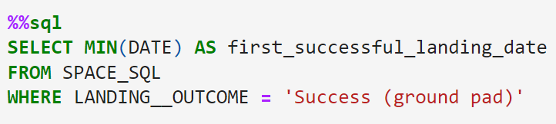
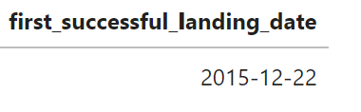
First Successful Ground Landing Date
Query
• Result
• Using the MIN() function to find out
the earliest date in the column
DATE.
• In the WHERE clause, filter the
dataset to perform a search only if
Landing__outcome is Success
(ground pad).

Slide 30
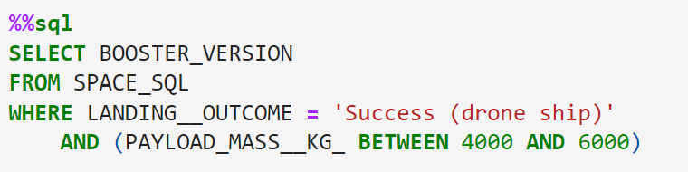
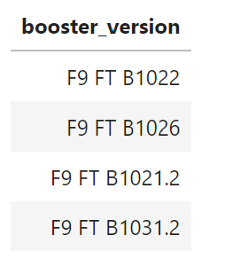
Successful Drone Ship Landing with Payload between 4000 and 6000
Query
• Result
• In the WHERE clause, filter the dataset to perform
a search if Landing__outcome is Success
(droneship).
○ Using the AND operator to display a record if
additional condition PAYLOAD_MASS__KG_ is
between 4000 and 6000.

Slide 31
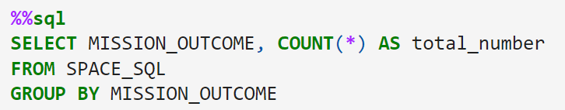
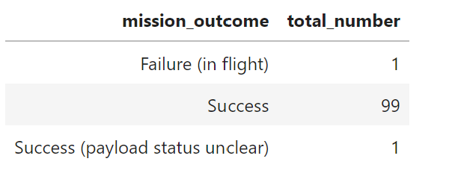
Total Number of Successful and Failure Mission Outcomes
Query
• Result
• Using the COUNT() function to
calculate the total number of
columns.
• Using the GROUP BY statement,
groups rows that have the same
values into summary rows to find
the total number in each
Mission_outcome.
• According to the result, SpaceX
seems to have successfully
completed nearly 99% of its
missions.

Slide 32
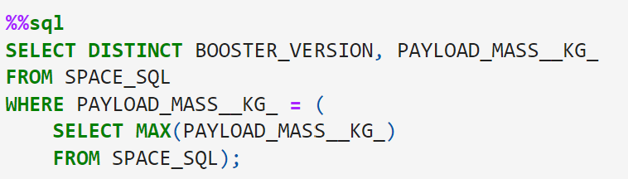
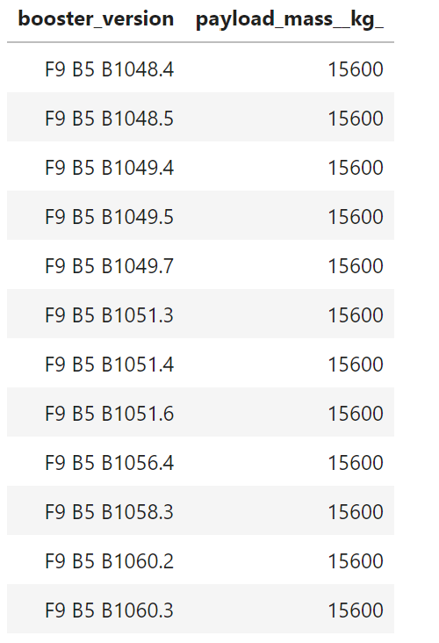
Boosters Carried Maximum Payload
Query
• Result
• Using a subquery, first, find the maximum
value of the payload by using MAX()
function, and second, filter the dataset to
perform a search if PAYLOAD_MASS__KG_
is the maximum value of the payload.
• According to the result, version F9 B5
B10xx.x boosters could carried the
maximum payload.

Slide 33
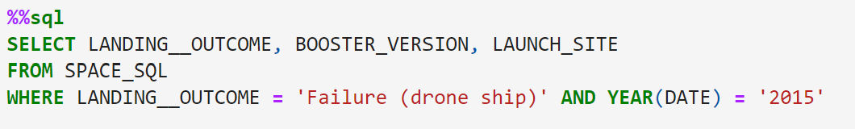
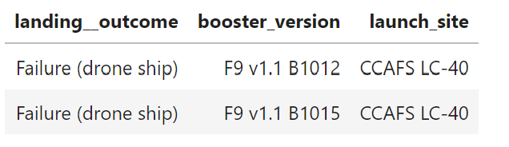
2015 Launch Records
Query
• Result
• In the WHERE clause, filter the dataset to
perform a search if Landing__outcome is
Failure (drone ship).
○ Using the AND operator to display a
record if additional condition YEAR is
2015.
• In 2015, there were two landing failures on
drone ships.

Slide 34
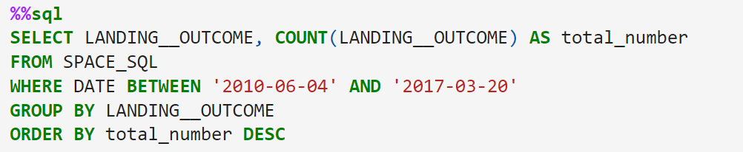
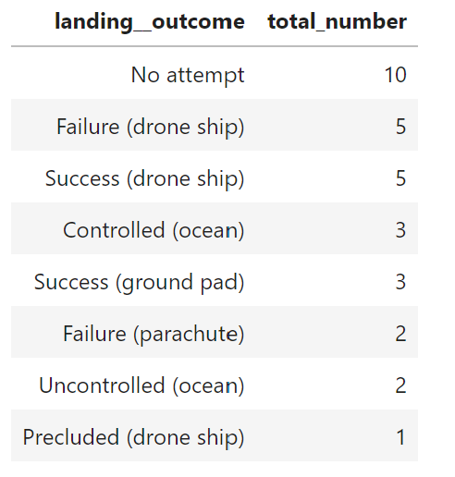
Rank Landing Outcomes Between 2010-06-04 and 2017-03-20
Query
• Result
• In the WHERE clause, filter the dataset to
perform a search if the date is between
2010-06-04 and 2017-03-20.
• Using the ORDER BY keyword to sort the
records by total number of landing, and
using DESC keyword to sort the
records in descending order.
• According to the results, the number of
successes and failures between
2010-06-04 and 2017-03-20 was similar.

Slide 35

Section 3

Slide 36
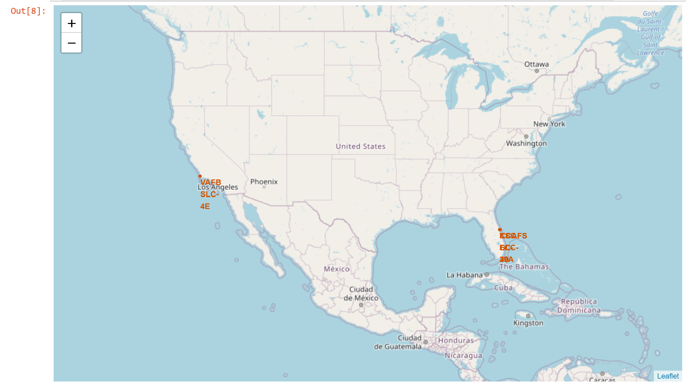
All Launch Sites’ Locations
The map shows all SpaceX launch sites, and the right map also shows that all launch sites are in the United States.
• As can be seen on the map, all launch sites are near the coast.

Slide 37
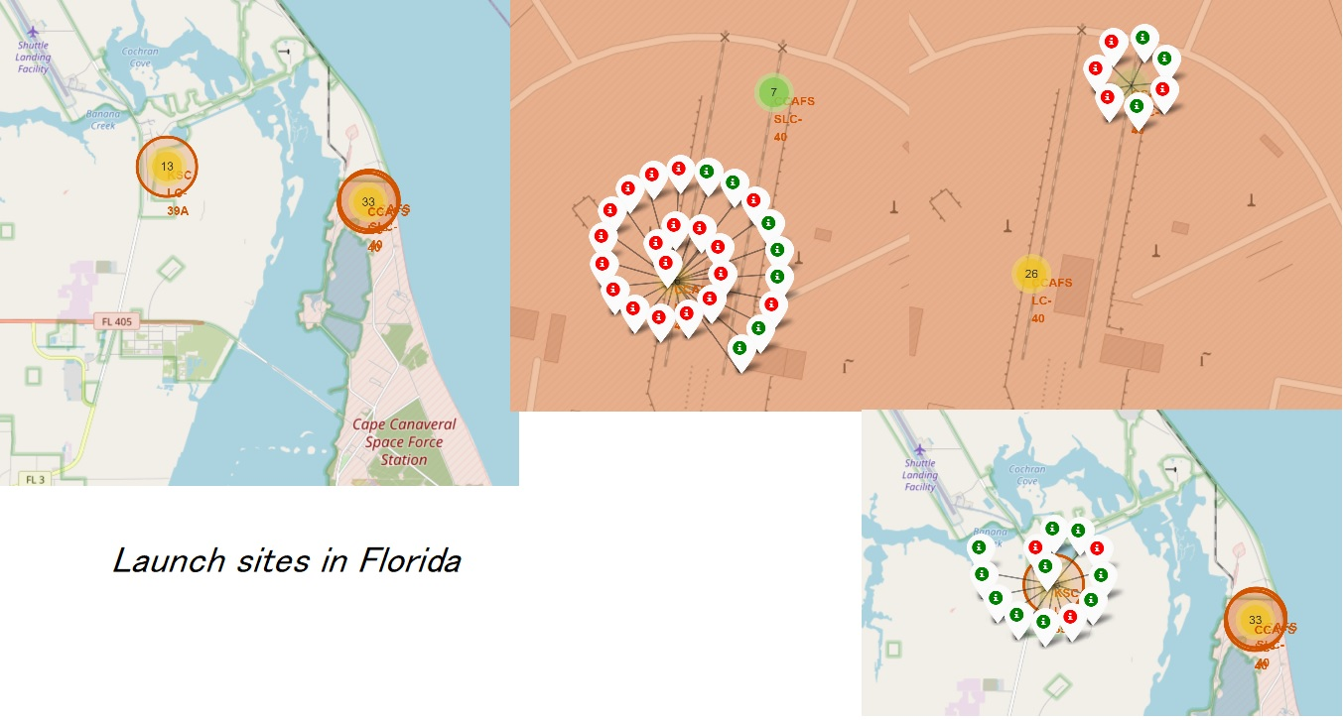
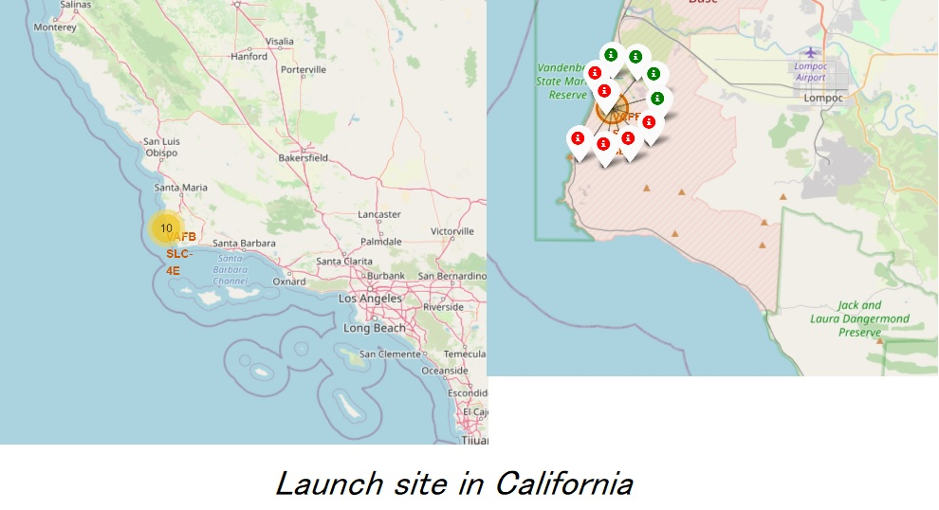
Color-labeled Launch Outcomes
By clicking on the marker clusters, successful landing (green) or failed landing (red) are displayed.

Slide 38
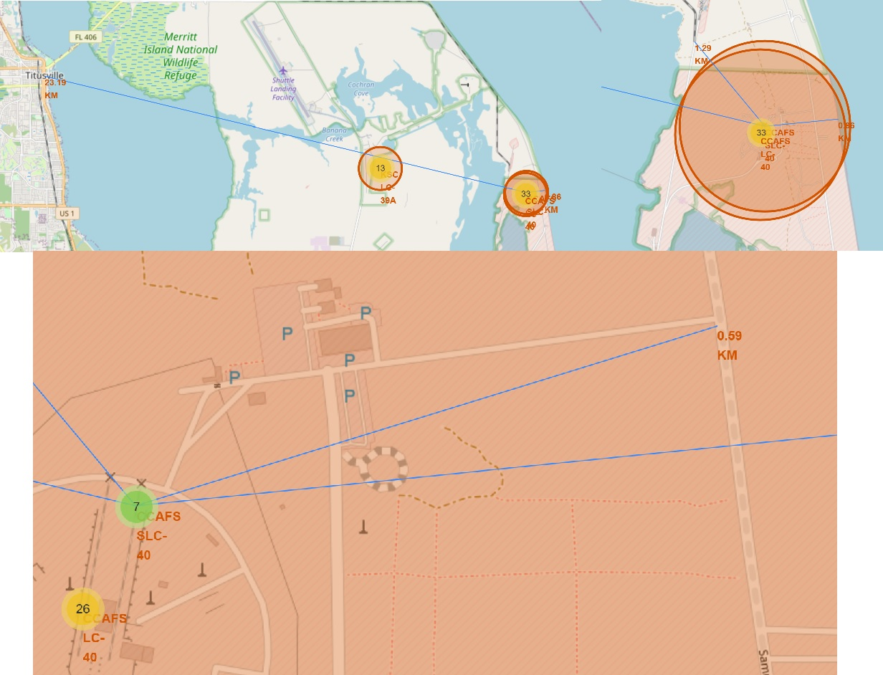
Proximities of Launch Sites
It can be found that the launch site is close
to railways and highways for transportation
of equipment or personnel and is also close
to coastline and relatively far from the
cities so that launch failure does not pose
a threat.

Slide 39

Section 4

Slide 40
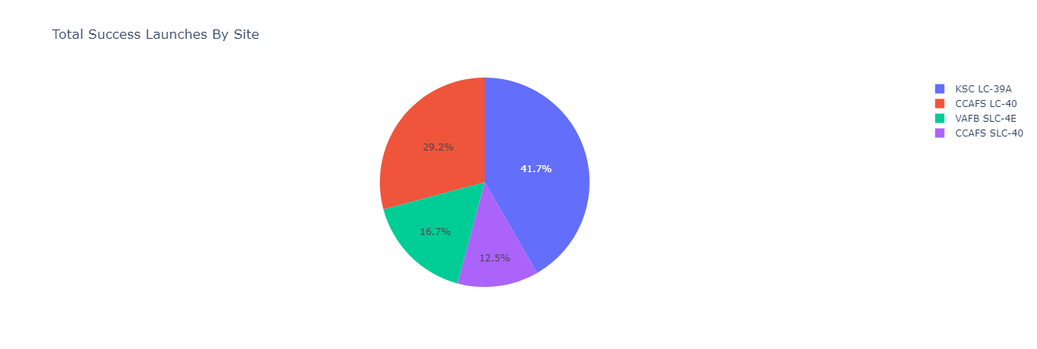
Total Success Launches By all sites
• KSLC-39A records the most launch success among all sites.
• The VAFB SLC-4E has the fewest launch success, possibly because
○ the data sample is small, or
○ because it is the only site located in
California, so the launch difficulty
on the west coast may be higher
than on the east coast.

Slide 41
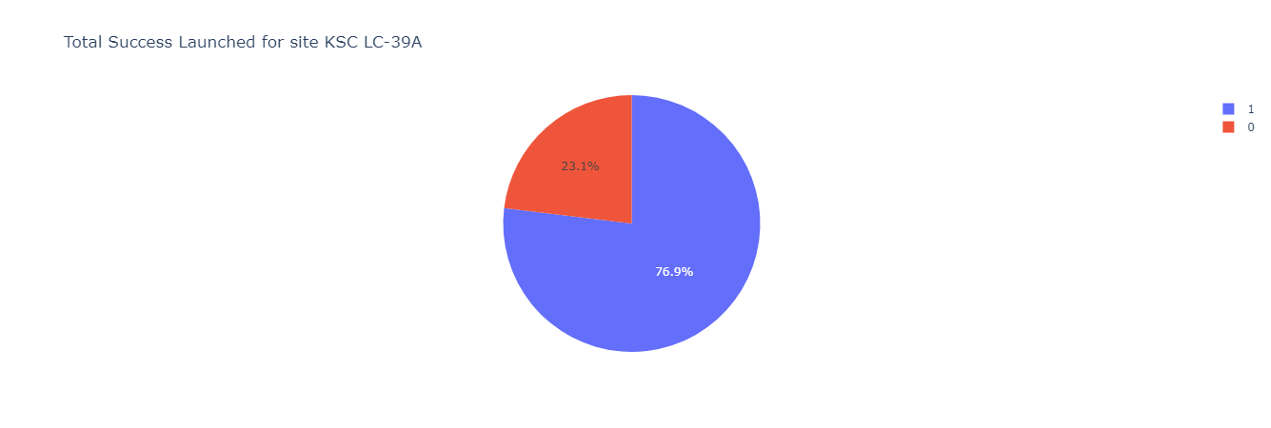
Launch Site with Highest Launch Success Ratio
• KSLC-39A has the highest success rate with 10 landing successes (76.9%) and 3 landing
failures (23.1%).

Slide 42
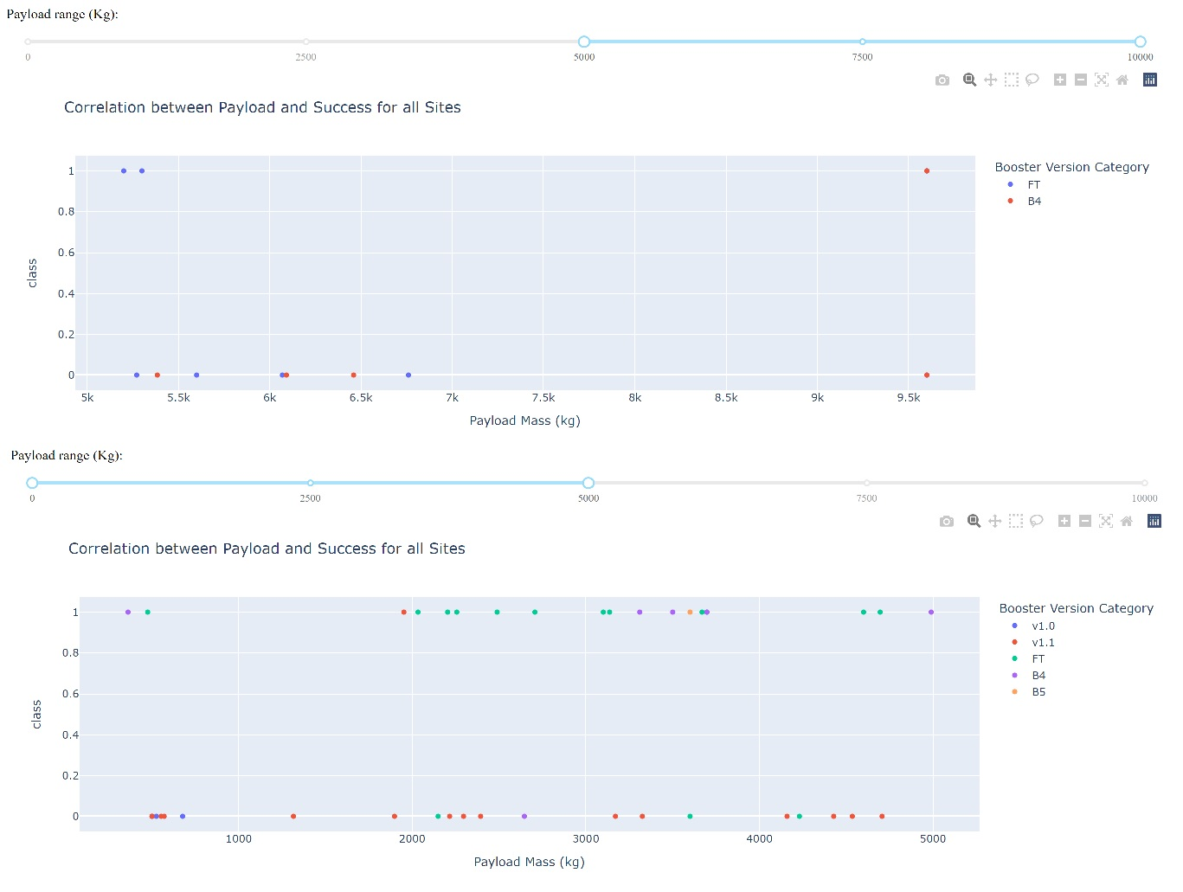
Payload vs. Launch Outcome Scatter Plot for all sites
• These figures show that the launch
success rate (class 1) for low weighted
payloads (0-5000 kg) is higher than that
of heavy weighted payloads
(5000-10000 kg).

Slide 43

Section 5

Slide 44
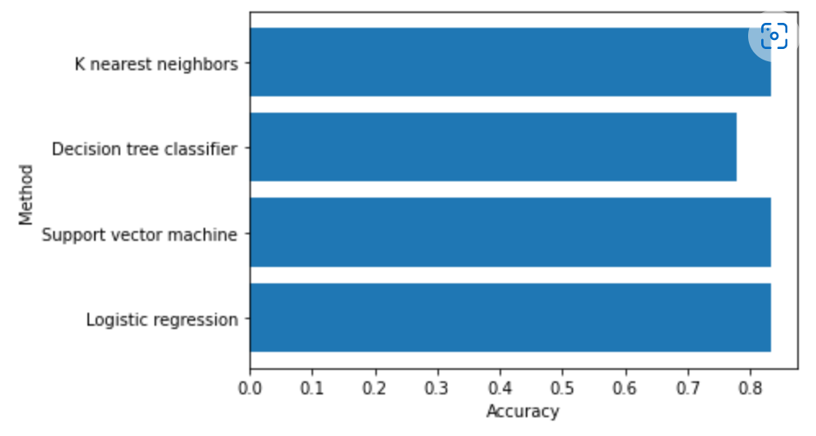
Classification Accuracy
• In the test set, the accuracy of three
models was virtually the same at
83.33%, one was 77.77%
• It should be noted that the test size
was small at 18.
• Therefore, more data is needed to
determine the optimal model.

Slide 45
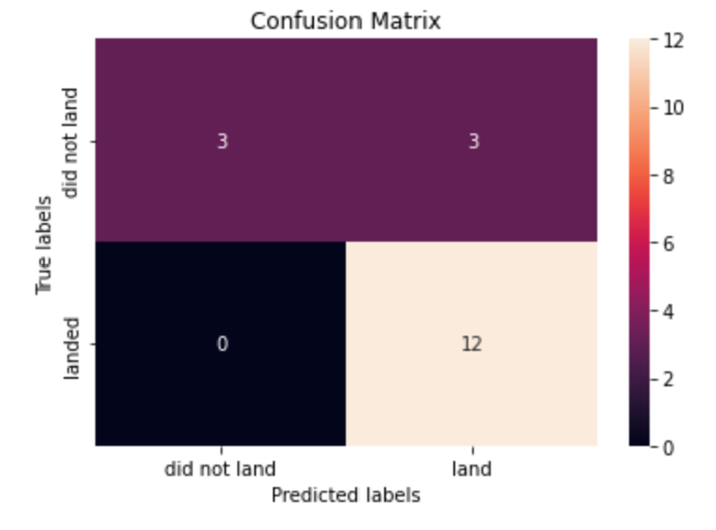
Confusion Matrix
• The confusion matrix is the same for all
models because all models performed
the same for the test set.
• The models predicted 12 successful
landings when the true label was
successful and 3 failed landings when
the true label was failure. But there
were also 3 predictions that said
successful landings when the true label
was failure (false positive).
• Overall, these models predict
successful landings.

Slide 46
Conclusions
As the number of flights increased, the success rate increased, and recently it has exceeded 80%.
• Orbital types SSO, HEO, GEO, and ES-L1 have the highest success rate (100%).
• The launch site is close to railways, highways, and coastline, but far from cities.
• KSLC-39A has the highest number of launch successes and the highest success rate among all sites.
• The launch success rate of low weighted payloads is higher than that of heavy weighted payloads.
• In this dataset, three models have the same accuracy (83.33%), one was (77.77%), but it seems that
more data is needed to determine the optimal model due to the small data size.

Slide 47
Appendix
mohkipic/Applied_Data_Science_Capstone_SPACE_X (github.com)

Slide 48


